Slide 1
Module 3.3
PRE-CLASS CONTENT
Predicates & Quantifiers
Predicate Calculus

Slide 2
Predicates and Quantifiers
All dogs are animals
Quantifier
Predicate
Subject

Slide 3
Limitations – Propositional logic
Propositional logic
cannot adequately express the meaning of statement
Predicate logic
Build on propositional logic by introducing quantifiers to handle special type of variables in mathematical statement

Slide 4


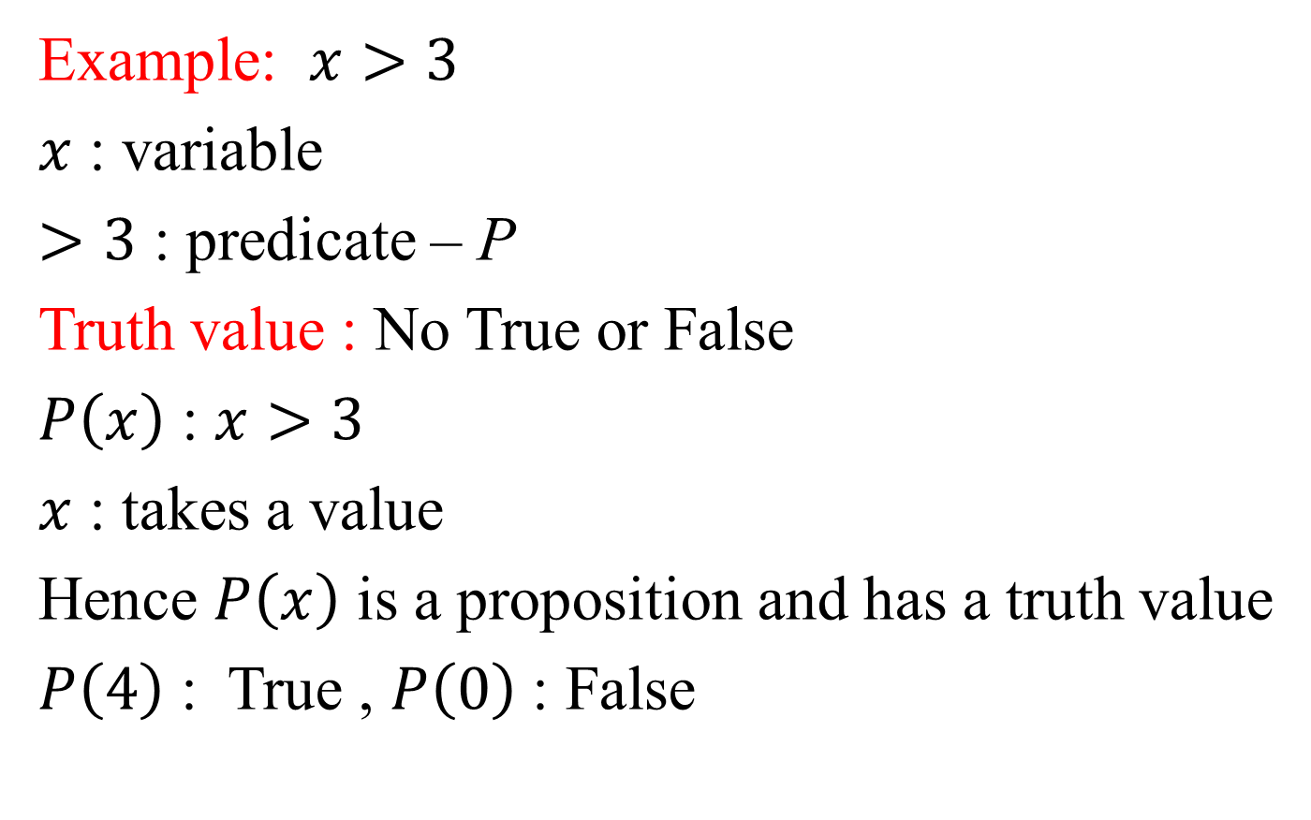
Predicates
Example: $x>3$
$x$ : variable
$>3$ : predicate – P
Truth value : No True or False
$P\left(x\right)$ : $x>3$
$x$ : takes a value
Hence $P\left(x\right)$ is a proposition and has a truth value
$P\left(4\right)$ : True , $P\left(0\right)$ : False

Slide 5


Quantifiers
Quantifiers are used to indicate the number of cases in a statement
ALL - each and every one
SOME - indicates at least one or several
Example:
- All hexagons have 6 sides
Some birds are angry

Slide 6
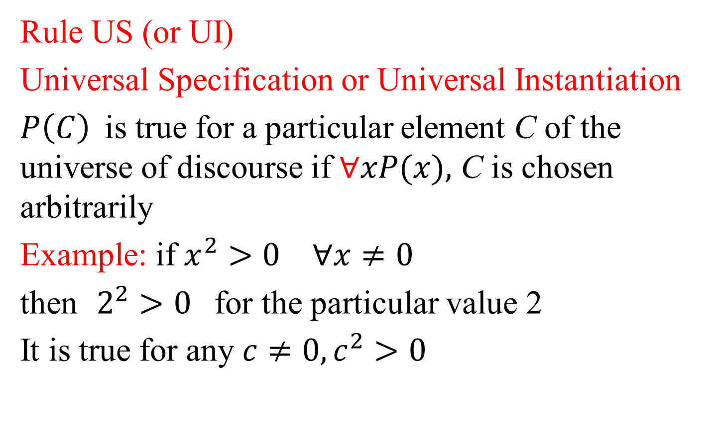
Inference Theory for Predicate Calculus
Rule US (or UI)
Universal Specification or Universal Instantiation
$P\left(C\right)$is true for a particular element C of the universe of discourse if $∀xP(x),$ C is chosen arbitrarily
Example: if $x^{2}{>0}^{ }∀x≠0$
then $2^{2}{>0}^{ }$for the particular value 2
It is true for any $c≠0, c^{2}{>0}^{ }$

Slide 7
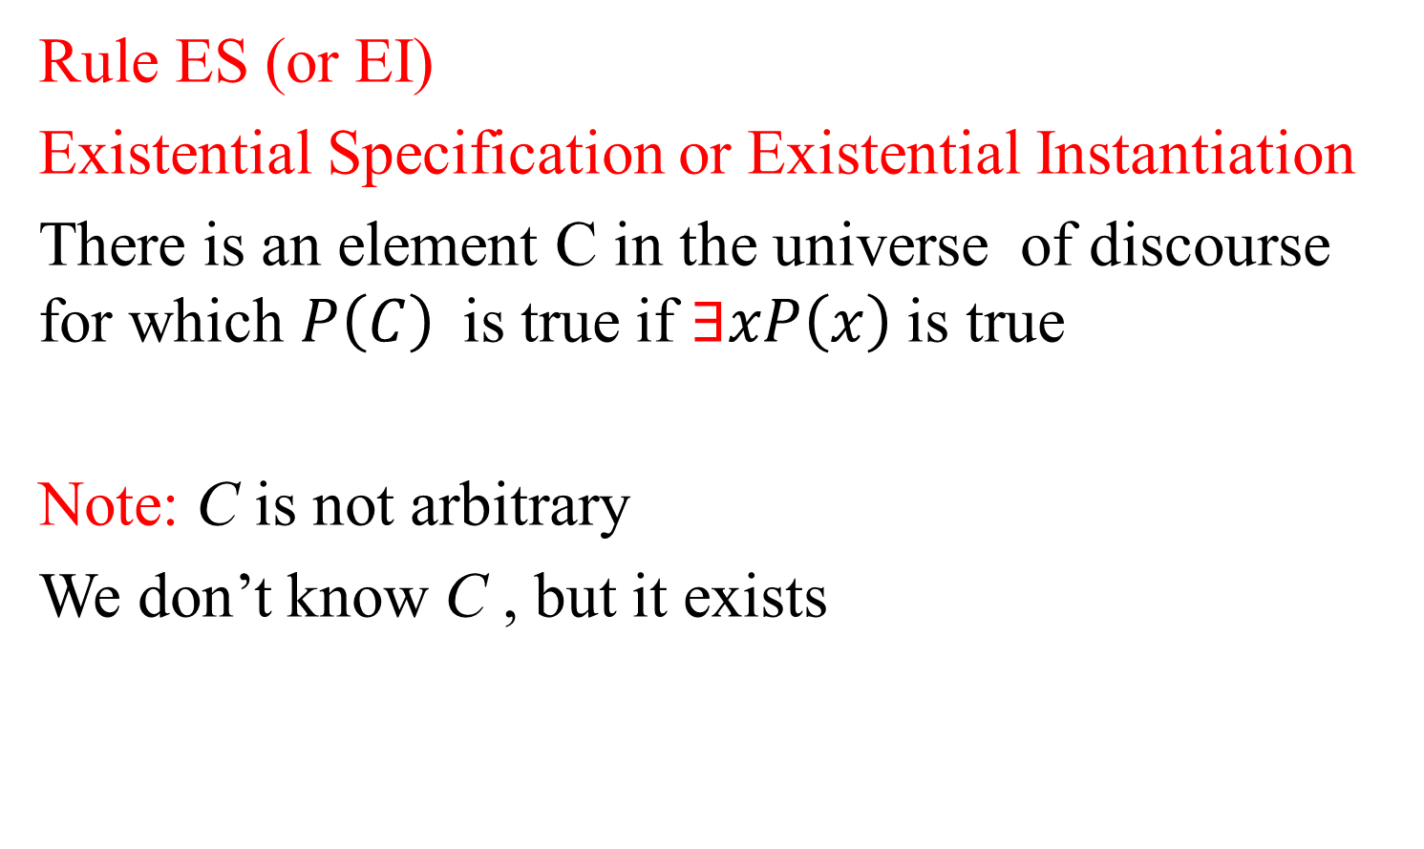
Inference Theory for Predicate Calculus
Rule ES (or EI)
Existential Specification or Existential Instantiation
There is an element C in the universe of discourse for which $P\left(C\right)$is true if $∃xP\left(x\right)$ is true
Note: C is not arbitrary
We don’t know C , but it exists

Slide 8
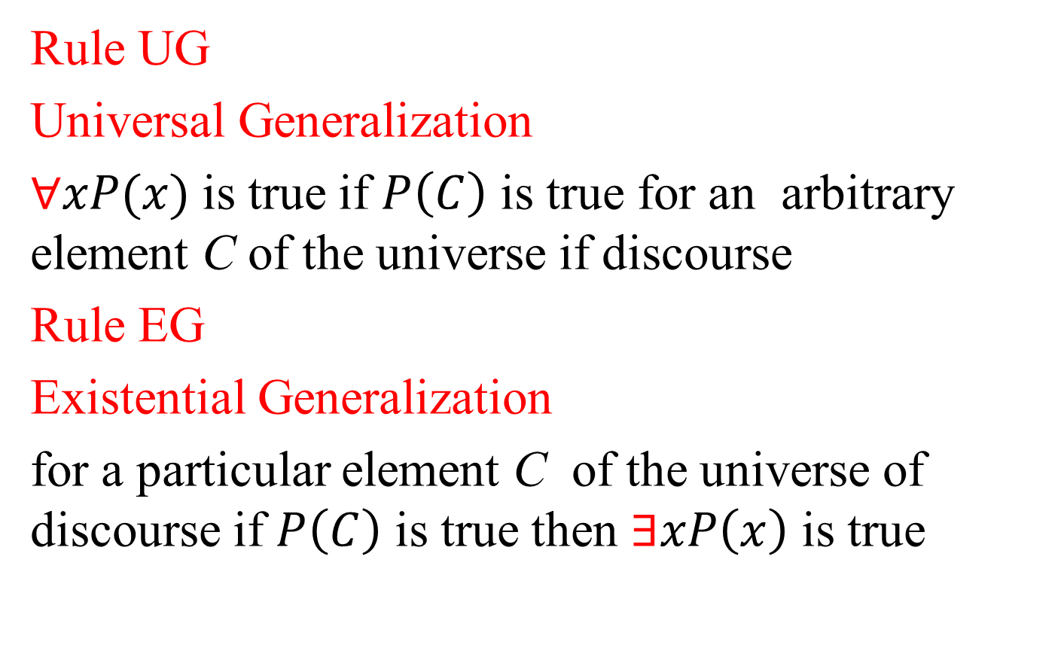
Inference Theory for Predicate Calculus
Rule UG
Universal Generalization
$∀xP(x)$ is true if $P\left(C\right)$ is true for an arbitrary element C of the universe if discourse
Rule EG
Existential Generalization
for a particular element C of the universe of discourse if $P\left(C\right)$ is true then $∃xP\left(x\right)$ is true

Slide 9
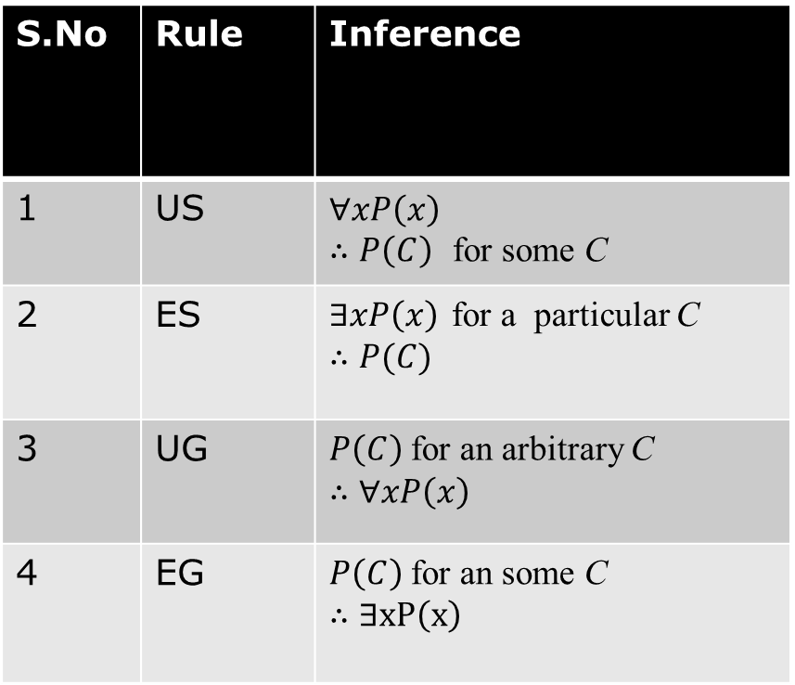
Summarize
S.No | Rule | Inference
1 | US | $$∀xP\left(x\right)$$ $∴P\left(C\right)$ for some C
2 | ES | $∃xP\left(x\right)$ for a particular C $$∴P(C)$$
3 | UG | $P\left(C\right)$ for an arbitrary C $$∴∀xP\left(x\right)$$
4 | EG | $P\left(C\right)$ for an some C $$∴∃xP\left(x\right)$$

Slide 10
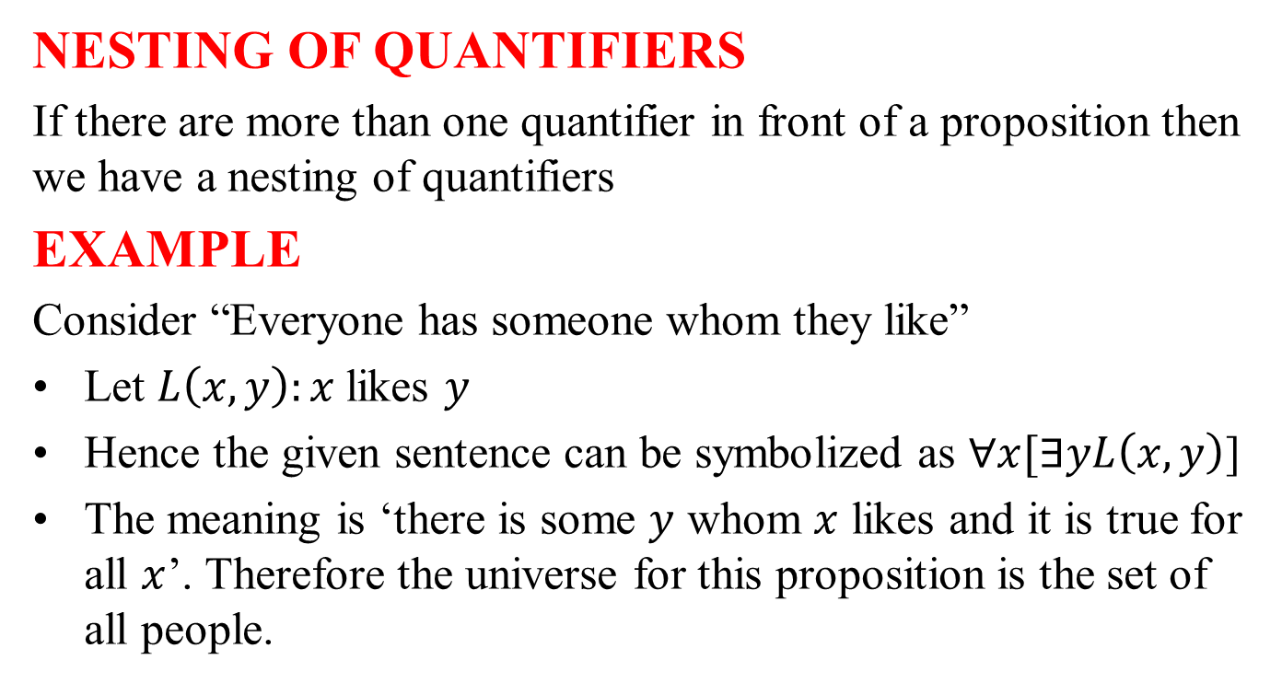
Nested Quantifiers
NESTING OF QUANTIFIERS
If there are more than one quantifier in front of a proposition then we have a nesting of quantifiers
EXAMPLE
Consider “Everyone has someone whom they like”
Let $L\left(x,y\right):x$likes $y$
Hence the given sentence can be symbolized as $∀x[∃yL\left(x,y\right)$]
The meaning is ‘there is some $y$ whom $x$ likes and it is true for all $x$’. Therefore the universe for this proposition is the set of all people.

Slide 11
IN-CLASS CONTENT PROBLEMS

Slide 12
PROBLEMS
Given the premises” A student of this class has not read the Discrete Mathematics text book” and “Every one in this class passed the first unit test” show that “Some one who passed the first unit test has not read the discrete mathematics book”
Show that the premises “one student in this class knows how to write programs in JAVA” and “Everyone who knows how to write programs in JAVA can get high paying job” imply the conclusion “Someone in this class can get a high paying job”

Slide 13
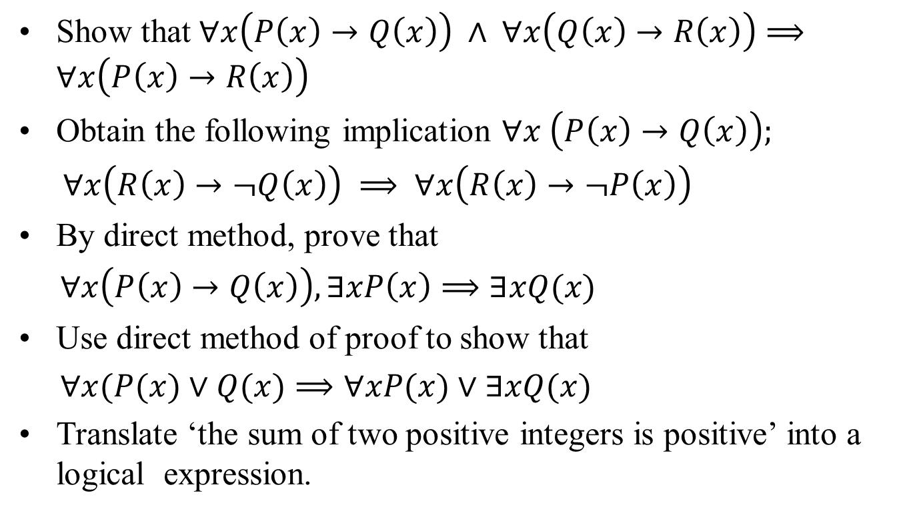
PROBLEMS
Show that $∀x\left(P\left(x\right)→Q\left(x\right)\right) ∧ ∀x\left(Q\left(x\right)→R\left(x\right)\right)⟹∀x\left(P\left(x\right)→R\left(x\right)\right)$
Obtain the following implication $∀x \left(P\left(x\right)→Q\left(x\right)\right);$
$∀x\left(R\left(x\right)→¬Q\left(x\right)\right) ⟹ ∀x\left(R\left(x\right)→¬P\left(x\right)\right)$
By direct method, prove that
$∀x\left(P\left(x\right)→Q\left(x\right)\right), ∃xP\left(x\right)⟹∃xQ(x)$
Use direct method of proof to show that
$∀x(P(x)∨Q(x)⟹∀xP(x)∨∃xQ(x)$
Translate ‘the sum of two positive integers is positive’ into a logical expression.

